Slide 1
State trustee candidates
FOP#88
Board Member Position

Slide 2
Candidates
Listed alphabetically
Debra Adkinson
Matthew Barnes
Franklin Boyer-Sears
Larry Doris
Bakhita Gum
Roderick Jacobs
Ross Mettscher
Joshua Osienger
Christopher (Bergner) Ryan
Micala Wessel

Slide 3
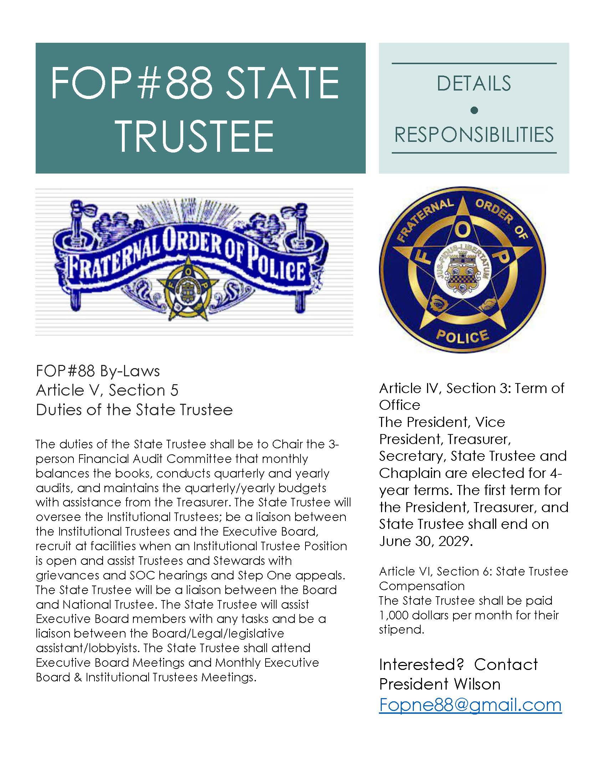

Slide 4
Debra Adkinson, Corrections Corporal
Reception and Treatment Center
Franklin Boyer-Sears, Corrections Sergeant
Reception and Treatment Center
Larry Doris, Corrections Corporal,
McCook Detention Center (WEC)
Bakhita Gum, Mental Health Specialist
Lincoln Regional Center
Ross Mettscher, Corrections Sergeant
Reception and Treatment Center
(Pictures and biographies were not submitted)

Slide 5
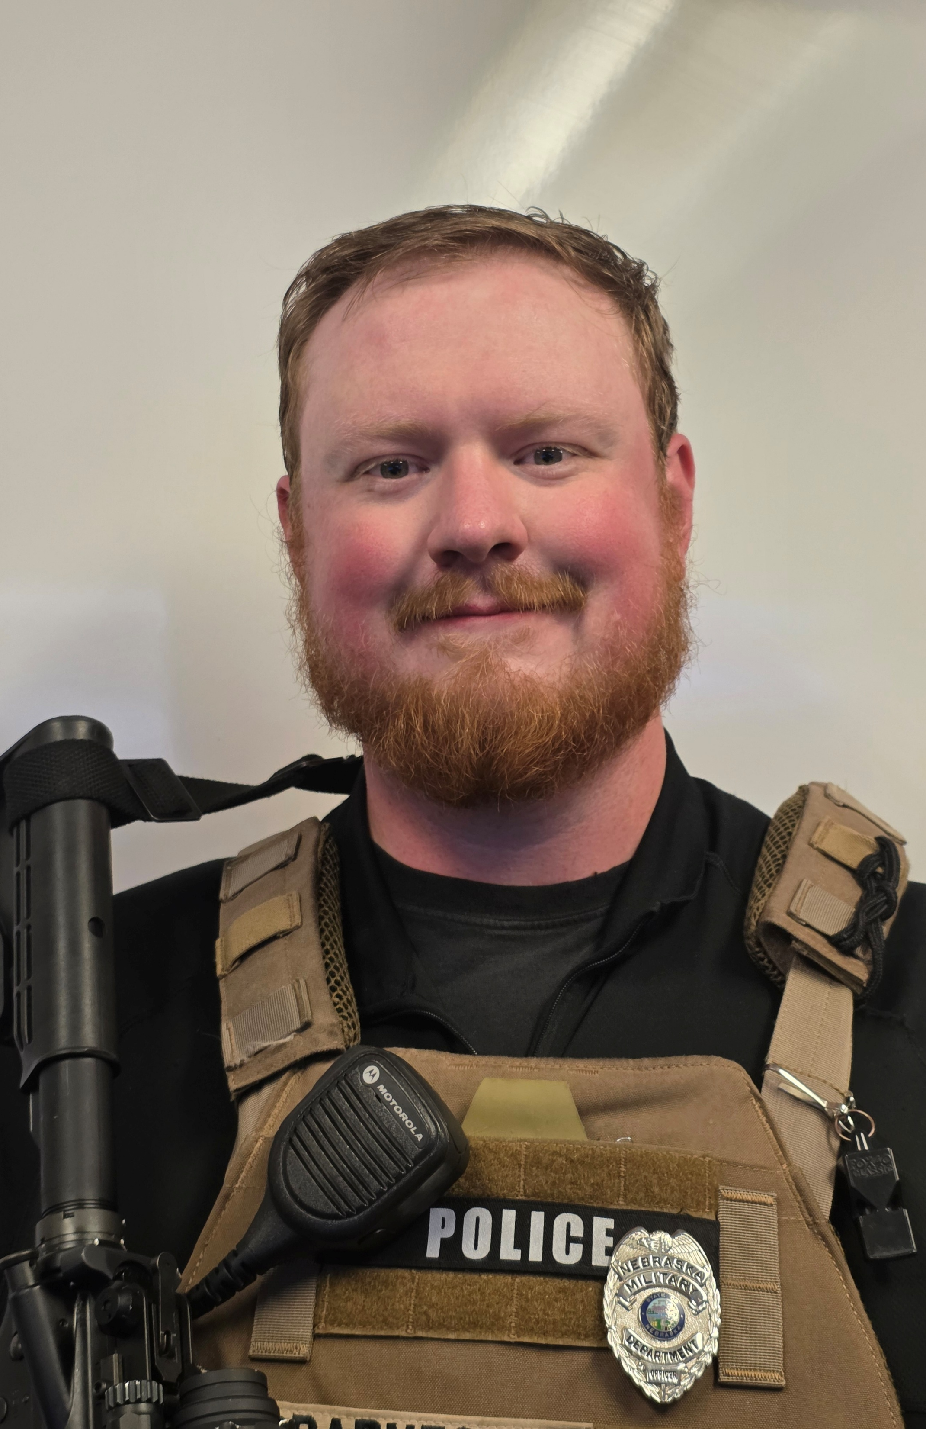

State Trustee Candidate Information
Candidate Name: Matthew Barnes
Current Facility: Military Department (NMD)
Title: Military Security Officer (MSO)
Being a native Nebraskan, I have spent most of my life in Lincoln. I have traveled to many places around the world and our great nation, but still always come back to what I love and know as my home. I have previously worked in childcare and youth sports, learning values of patience, listening and understanding. Likewise, I learned many life lessons while working in underground construction, learning about myself and how to handle high intensity situations in extreme conditions and timeframes. Using those skills and knowledge, I made the venture to found and operate my own private security contracting company, where I developed the ability to negotiate and write contracts and agreements. However, my passion is for public service. To be our Lodge’s State Trustee, to serve those who serve, would be a great honor.
I currently work for the State Military Department, providing the armed security detail to the Nebraska National Guard Headquarters, at the Lincoln Air Base. I have also previously worked as a Capitol Guard for the Nebraska State Patrol’s Capitol Security Division. Having been a member of the Fraternal Order of Police Lodge #88 for multiple years, I have had several instances of becoming familiar with the importance of having a strong union to support me. Soon after starting at the Military Department, I became a Steward for my current facility, working to help my Trustee, Jason Walter, to represent the members in our facility. During my time as Steward, I have also been working to better understand the needs of other facilities. In my efforts to better serve my fellow union members, I have become studious of our current Labor Contract, Nebraska State Statute, and United States Code. I have continued to promote a proactive work environment by developing a monthly “newsletter” that provides simple correspondence with the members I represent as their Steward. Also, I have been helping build relationships with the Command Staff/Administration at our facility, improving the ability to facilitate and expedite improvements in the workspace. I have also been making connections with our local and State politicians, having been a delegate to the Lancaster County Republican Party; I have not only represented my Legislative District, but also worked to gain contacts with some of the candidates for public offices. I intend to continue to build these bonds, and leverage my desire for our improved employment, to create effective and efficient workspaces.
I have sat-in on as many monthly Board/Trustee meetings as I could in the past 3 years of being Steward, and attended this year’s State FOP Convention to represent our Lodge. I believe this has helped me better understand my fellow members, even though we may work in different facilities. Again, I would be honored to help ignite the flame and develop the post of State Trustee for FOP Lodge #88, and thank you for your continued support for our union as a whole!

Slide 6
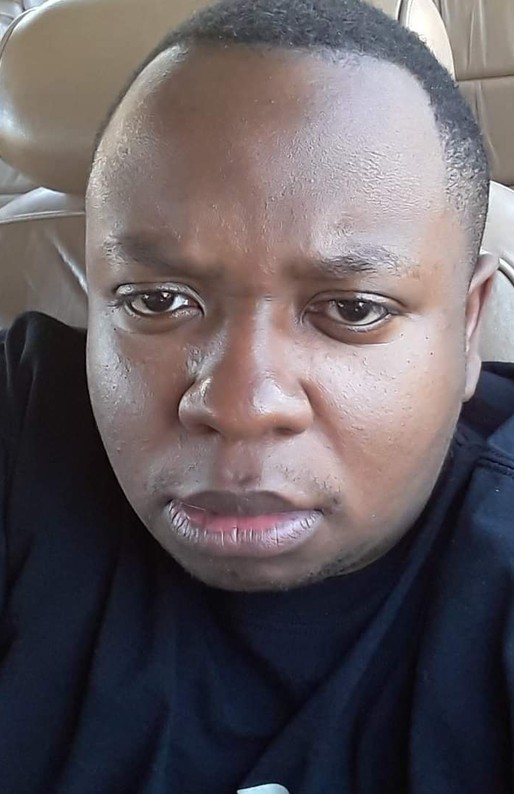
Brothers and Sisters,
My name is Roderick Jacobs, and I am running for FOP State Trustee.
I started my corrections career in Kentucky, then served with the Oklahoma Department of Corrections as Crisis Negotiation Team (CNT) Team Leader, Correctional Emergency Response Team (CERT), Training Officer, and Disciplinary Officer. I was a Sergeant and stepped up as Acting Lieutenant more than once.
I have been with the Nebraska Department of Correctional Services (NDCS) for four years.
I am not a politician. I will not be thinking about the money, and I will not be chasing a relationship with administration. This is about the membership — not the administration. If you elect me, my only job is taking care of our members: wages, safety, discipline, and backing you when it counts.
I don’t need a title. I need your trust. Vote Jacobs — members first.
Roderick Jacobs
Candidate for FOP State Trustee

Slide 7
My name is Joshua Osienger and I have worked for the department of corrections since August of 2013. When FOP88 first started, I spent many nights with our previous board members working on gathering signatures and getting the word out about the FOP. When the first election for FOP 88 was voted upon by our membership, I was elected to the first executive board as Vice President 2 of the union. When it was decided to move the board to a four-man board, with two full-time employees, I decided I would rather become an institutional trustee instead of running against the other nominee for vice president. During my time as a trustee, I have sat in numerous labor management meetings and have developed a rapport with many of NSP’s administration and Lieutenants. Me and my other trustees have always tackled our problems head on and if things were out of line, we were usually there first, fighting for our fellow coworkers. I will not say that we were perfect in what we have accomplished but if any issue was brought to me, I was going to fight for my fellow team members. I am not afraid to voice my concerns with anyone and if we could settle the issue before it became a problem that was always the goal I strove to achieve.
I have sat on multiple bargaining committees. We have done some amazing things for the Nebraska Department of Corrections as the FOP88, and the state has historically been challenging to cooperate with. There is still a lot of work that needs to be accomplished. Better insurance, possibilities of a pension, and we need to look at language within our contract that has an issue with vagueness. The ability to have a meeting of trustees and communicate with other institutions on a regular basis will allow me to see the issues plaguing our department and bring these issues to the forefront to be changed and fought for. Being a State Trustee will also allow me to better communicate with other lodges and see how they do things in other areas. We can learn from each other and build the best possible version of the Department of Corrections through bargaining.
I have always prided myself on being able to see multiple angles of the same issue. Always trying to find out where the issues lie and how we can tackle them. There is never just one answer to the same problem. Management will see one answer and employees will see many other answers. The goal is to find the answer that appeases both sides. We are a team and that includes the people who work as our supervisors. People don’t quit their jobs, they quit their bosses. We must foster great working relationships with the department's administration to better our coworker’s working environment. The great way to do this is with open communication in labor management meetings. A place where the front-line staff can voice their concerns and where management can get their voices heard so we know exactly what they are thinking and why they are making the decisions to do what they do.
One of the main things that needs to happen as a State Trustee is to reach out to the National Trustee and form a good working relationship. We need the state FOP to see us as a vital part of their agenda and that all our concerns are just as big of an issue as the fellow FOP members of the police force. We need to make sure we are not left off legislative bills that better just a small part of the state FOP members, when the bill should better ALL the state FOP members. Attending the state conference for a few years now has put in perspective that we need to make meaningful relationships and show our worth as members of this great union. The state FOP has made a jump in the right direction by nominating a Vice President of Corrections. Now is our time to make better connections and get our voices heard.
I am a self-starter and motivator. I have never had an issue with working hard and keeping to the task on hand. I have been the admissions corporal at NSP for over 8 years. I have my hands in a lot of different areas and I have always made it my top priority to meet deadlines. One of the main things for our executive board is to stay on schedule, not be late, and meet the deadlines set by our labor contract. I can meet these deadlines in the appropriate amount of time. That way we are not dropping the ball for our team members who put their trust in us.
Even though I am not currently a trustee for NSP, I still attend meetings when I have the chance and am still a main figurehead for NSP in answering any union related issues. The union has been a huge part of my career while I have been with the department, and I would consider it an honor to represent all of us and bring us all together. We started this union as a family, and we will strive to keep this union a family. Please consider me for the position of State Trustee when you place your vote.
Thank you for the opportunity,
Joshua Osienger

Slide 8
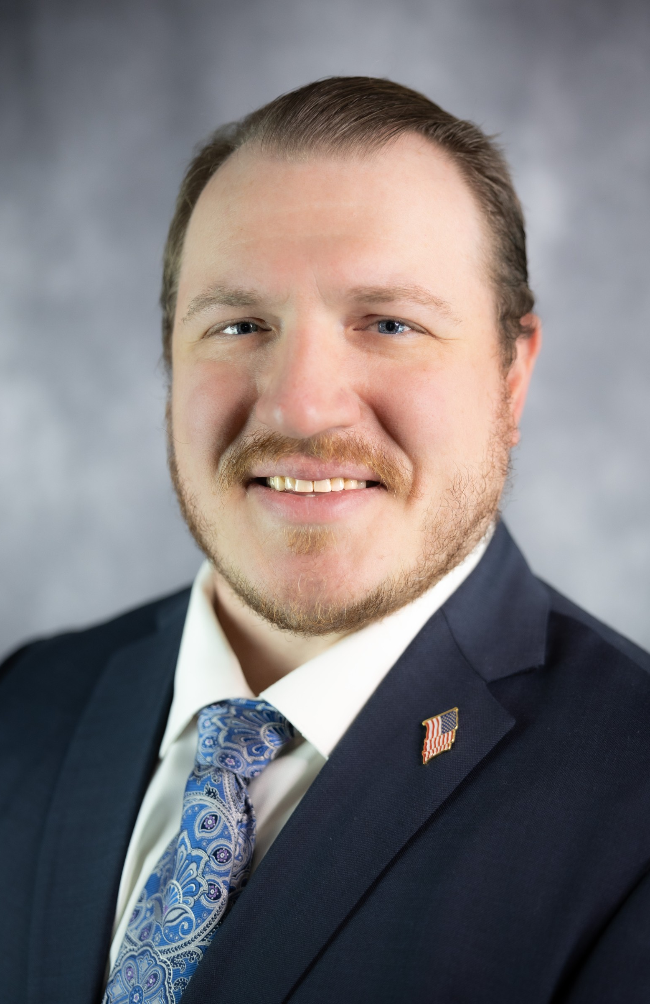
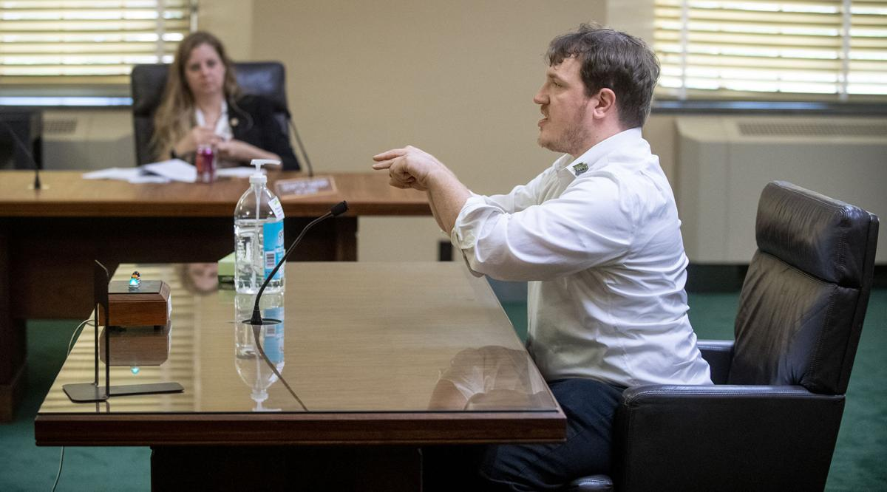
HELLO!
My name is Christopher Ryan (Bergner), and I am writing to officially declare my
candidacy for the position of State Trustee. Since joining our department in
August 2020 at the height of the global pandemic, my career has been defined by
proactive advocacy, decisive action, and an unwavering commitment to our
membership. Early in my career on the NSP Special Detail, I recognized the
urgent need to protect our staff during unprecedented staffing crises and
spearheaded a 24-person class-action grievance that successfully saved the jobs
of 24 dedicated team members. Recognizing my dedication to our shared mission,
leadership appointed me as the NSP FOP Trustee, giving me a broader platform to
fight for our frontline staff. In this role, I stood before the State Senate, straight
off an 18-hour shift, to provide critical, firsthand testimony on our working
conditions, a pivotal effort highlighted by both the Lincoln Journal Star and
the Omaha World-Herald that ultimately helped secure a monumental 40% raise for
our membership.
My dedication to operational excellence and member representation continued when I
transferred to OCC in February 2022. Honored by my peers, I won the election
for OCC Trustee, earned Employee of the Quarter recognition, I joined CERT, and
actively contributed to policy
modifications that delivered tangible, real-world support to our staff in the
field. Beyond institutional leadership, I have repeatedly stepped up at the
bargaining table, actively serving on our FOP contract negotiation teams in
2022, 2024, and 2026 to safeguard our working conditions, benefits, and
competitive compensation. My career has been rooted in the FOP from the very
beginning, and I possess both the proven track record and the vision necessary
to lead, modernize, and unify our organization moving forward.
As your State Trustee, I will bring an aggressive, accessible, and modern approach to
union leadership. I will make myself readily available throughout the week as a
deeply knowledgeable subject-matter expert on our contract, ensuring every
member has a responsive and dependable ally in their corner. My vision focuses
on elevating our public presence through expanded community outreach and
establishing a robust communication network—keeping institutional bulletin
boards and social media channels continuously updated so you receive timely,
transparent information directly from union leadership. Furthermore, I am
committed to building an inclusive, collaborative coalition of board members,
trustees, stewards, and general members to drive active engagement and
implement fresh, creative approaches to involvement.
Outside of work, I enjoy reading, collecting Pokémon, working out, cooking, playing video games, and spending time outdoors with my wife.
I ask for your vote so that together, we can build a stronger, more transparent, and truly united Fraternal Order of Police. Thank you for your time and consideration!
Best regards,
Christopher Joseph Paul Ryan (Bergner)

Slide 9
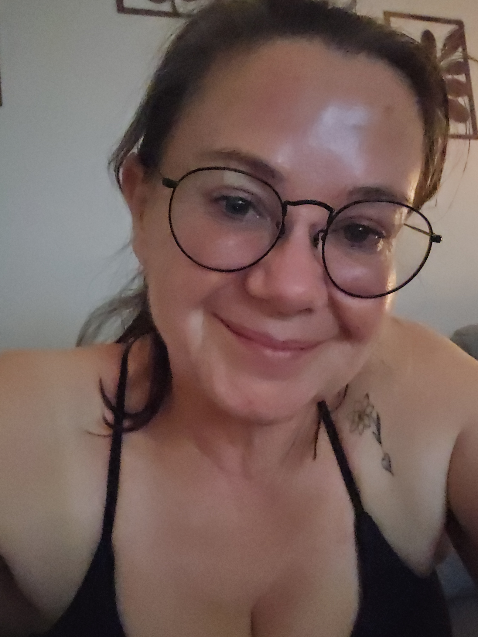
Hello fellow FOP Lodge 88 members,
My name is Micala Wessel. I work first shift at the Nebraska State Penitentiary (NSP), and I am running for the State Trustee position for FOP Lodge 88.
Communication across our facilities is vital. If elected, I plan to coordinate a monthly report from each institution and facility so we can keep each other in the loop. Staying connected ensures we are all updated on the changes, challenges, and developments happening across our state facilities.
I am approachable, personable, and passionate about supporting my coworkers—helping the people I work with has always been, and will always be, my driving force.
Over my 17 years at NSP, I have dedicated myself to serving our staff in multiple roles:
Field Training Officer (FTO): Spent 11 years training and guiding new staff.
CERT Team: Served 5 years on the emergency response team.
Union Representation: for 6 years now.Transitioned into union advocacy, where I currently handle grievances with a 95% success rate and maintain a 100% success rate assisting members during official statements.
I have the experience to train, guide, and keep our members connected across facilities while providing you with the tools you need to succeed.
If I have ever helped you or made a positive impact on your career, I would appreciate your support.
Vote Micala Wessel for State Trustee.

Slide 10
Conclusion
Watch for an email from the FOP#88 to vote in the primary election for your chosen candidate soon.

