Slide 1
Chaplain candidates
FOP#88
Board Member Position

Slide 2
candidates
Steve Harner
Michael Sobota

Slide 3
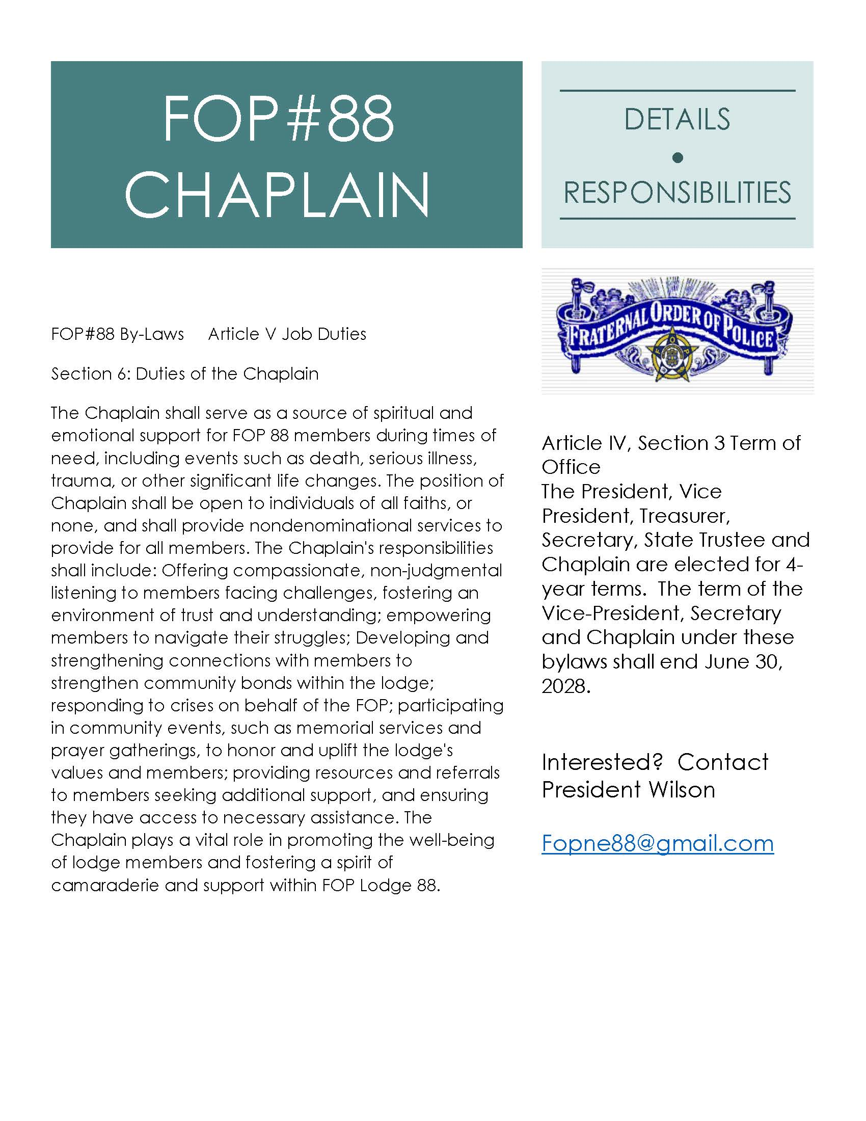

Slide 4
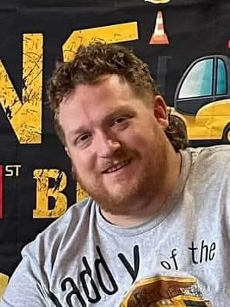
Steve Harner, Corrections Unit Caseworker
Corrections Community Center – Lincoln
I am interested in the Executive Board Position of the FOP Chaplain. I currently have 15 years of law enforcement/corrections experience. I started in Pueblo County as a Sheriff’s Deputy in Pueblo, Colorado. I started in the jail and eventually went to patrol. I’ve been around a lot of not so friendly things there. Pueblo, CO was the deadliest city in the United States while I was there. I was awarded a Pueblo’s Best Award, which is voted on by the citizens of Pueblo County. I was always compassionate with anyone I came across, wearing blue or not. I made the switch to Colorado Department of Corrections in 2018. I quickly rose up the ranks and became a Supervisory Sergeant before leaving for Nebraska. I supervised some great people. I always accepted my faith as a crutch to bear the burden of the badge. I was awarded multiple awards through my career. I have 2 Purple Hearts, 3 life saving medals, a team leadership medal, a team excellence medal to name a few. I have always been there for people I have worked with. I am still a helpful ear to those I have worked with in Colorado and continue to bring that mentality in Nebraska.

Slide 5
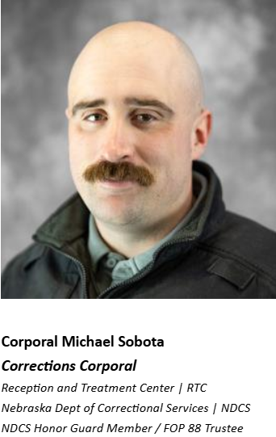

My name is Michael Sobota, and I am running for the position of Chaplain for the FOP Lodge 88. I am married to my wonderful wife Nicole, and together we have 7 children between the ages of 17 and 2 months. I have 14 years in the Army Reserves as a Blackhawk helicopter mechanic and Combat Medic with multiple mobilizations and deployments under my belt. I am a baptized catholic but treat all faiths with the same respect and dignity that I give to my own.
I began my career with NDCS in 2022 at TSCI, and in 2024 I transferred to RTC where I am now one of two FOP Trustees. I also am on the NDCS Honor Guard and represent the department at numerous functions inside and outside our agency with a sense of duty, respect and honor.
I have been a FOP member since my career began and have been heavily involved in the union for a year now, representing and assisting our brothers and sisters whenever it is asked of me, bringing thought and common sense to the issues at hand. I was selected by FOP President Jay Wilson to be on the 2027-2029 contract bargaining team and am excited to represent and advocate for all of us in Protective Services. I am currently putting together a fundraiser for the FOP Benevolent Fund, so that we can assist our members in times of need. One of my biggest concerns is the morale and the general wellbeing of our teammates both on duty and off. So many times, I am told negative things by our coworkers. My job is to listen and understand. If elected, I want to be the heartbeat for our union. I will bring your concerns to the board with understanding and care, working with our team of trustees, stewards, board members and members to advocate and create a better working environment for us all.
Outside of work, I enjoy spending time at the park with my wife and kids, hunting, fishing, grilling and playing Helldivers 2 with my friends.
I would appreciate your time and consideration for your vote for Chaplain of the FOP Lodge 88.
Very respectfully,
Michael J Sobota

Slide 6
Conclusion
Watch for an email from the FOP#88 to vote on your chosen candidate soon.

